Slide 1
Back to School Night Welcome Parents
Mrs. Hong
Ms. Le
Ms. Leydig

Slide 2
Our 7th Grade Team

Slide 3
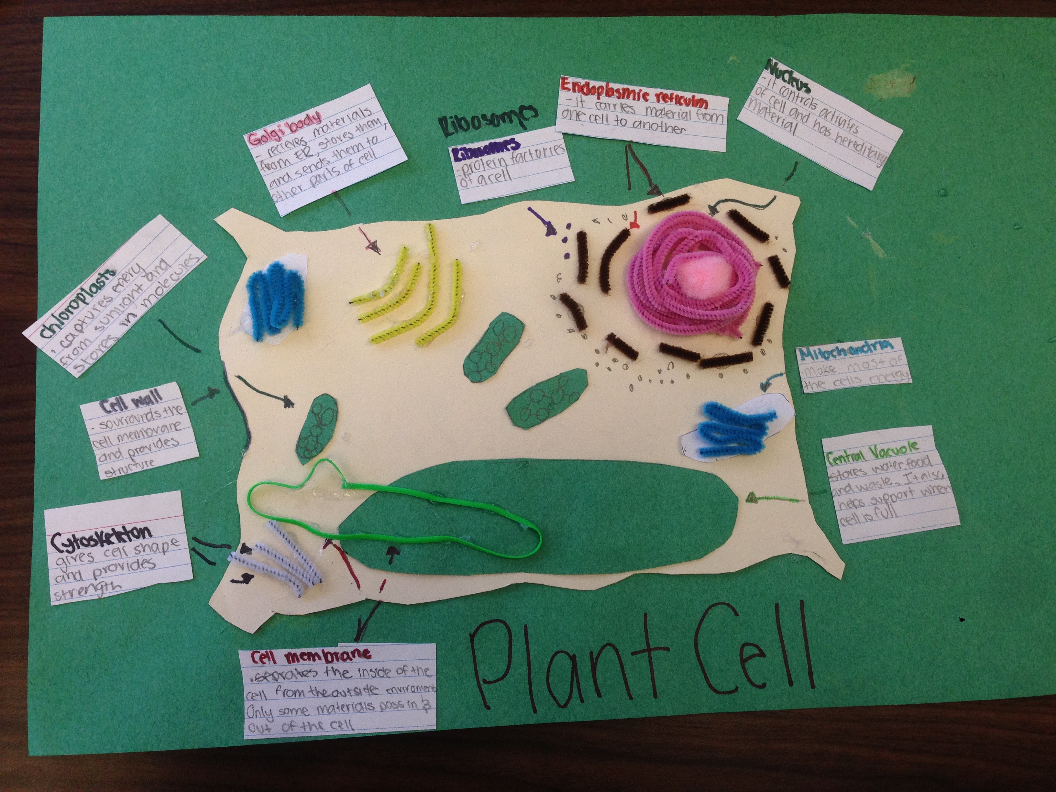
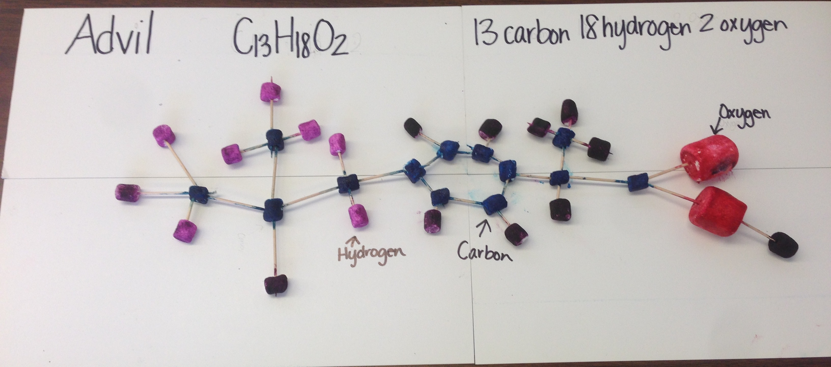
Curriculum Overview
Math -College Preparatory Math (CPM)
-Intervention Math Class
-Class information @ www.mslesclass.weebly.com
ELA
-Reading, Writing
-AR and Reading Intervention, Nightly Logs
-Amplify
Science PBL
Social Studies PBL
Electives, PE, Music, Garden, Leadership, Yearbook..
Fieldtrips

Slide 4
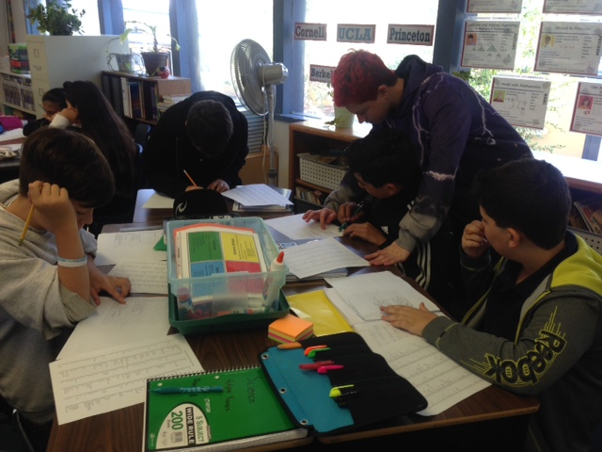
Assignment Policy
Homework
Test Correction
Late Assignment
Cheating

Slide 5
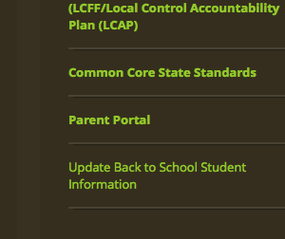
Grading Policy
What We Grade
-Participation/Homework/Notebook
-Tests and Quizzes
-Projects and Presentations
Parent Portal
Progress Report
Trimester Report Cards
Principal’s Honor Roll (3.8 – 4.0 GPA)
Honor Roll (3.25 – 3.79 GPA)
Academic Probation (2.0 or less GPA)

Slide 6
Middle School Uniform
http://www.rcsd.k12.ca.us/domain/908
And…
Cell Phone Permit

Slide 7
Contact Information
Classroom Website = mslesclass.weebly.com
Emails:
jle@rcsdk8.net
khong@rcsdk8.net + remind app.
eleydig@rcsdk8.net
Phone: (650) 482-2413

Slide 8
We Love Our Parent Volunteers
Your Name
Contact Information
Your Availability
What can you do?(fieldtrips, classroom materials, school events…)

